Slide 1
Flight Price Prediction
Submitted by:
Arshi Maitra

Slide 2
Acknowledgement:
This project has been completed with the help of training documents and live classes recordings from Data Trained Education. Few help on coding have also been taken from few data science websites like Toward Data Science, Geek for Geeks, Stack Overflow. All data related to the flight price has been taken from www.yatra.com

Slide 3
INTRODUCTION
The prices in a flight vary quite unexpectedly and The cheapest available ticket on a given flight gets more and less
expensive over time. This usually happens as an attempt to maximize revenue based on - a). Time of purchase patterns (making sure last-minute purchases are expensive) b) Keeping the flight as full as they want it (raising prices on a flight which is filling up in order to reduce sales and hold back inventory for those expensive last-minute expensive purchases)
Therefore the main goal of this project is to determine the following:
⦁ To predict the flight price of various airlines
⦁ To understand the factors that are responsible for the increase or decrease of a flight price.
The following data has been taken from yatra.com. Here the flight price of various airlines that travel from Delhi to Mumbai between 30th October to 6th November has been taken into account. Based on the data available, following conclusions have been made and predicted as to what determines the price of flight and exactly in what pattern does the flight price increase or decrease.

Slide 4
Analytical Problem Framing

Slide 5
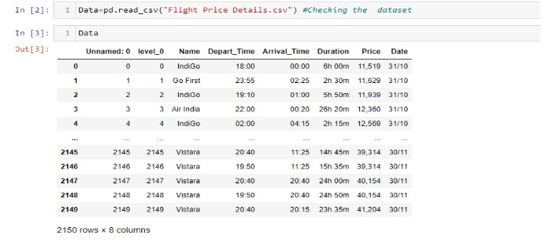
Web Scraping
Before importing the necessary libraries for data analysis and prediction, the data has been first scrapped from the website www.yatra.com by using the Selenium method from Web Scraping. The data is saved in CSV which is later on used for analysis:

Slide 6
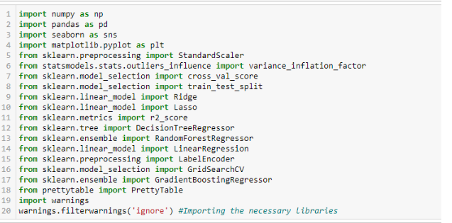
Importing Necessary Libraries

Slide 7
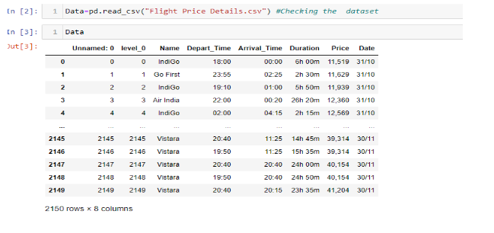
Data preprocessing/Data Cleaning:
Loading the dataset

Slide 8
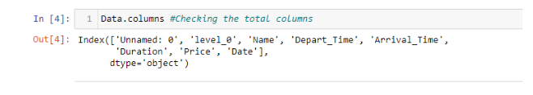
Going through the columns of the data:

Slide 9
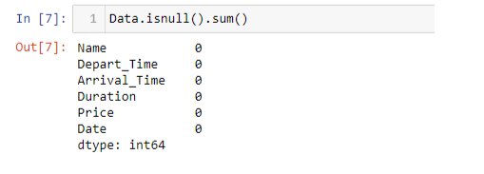
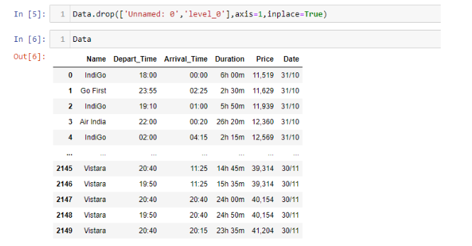
Checking the null values from the data:
Dropping the unnecessary column:

Slide 10

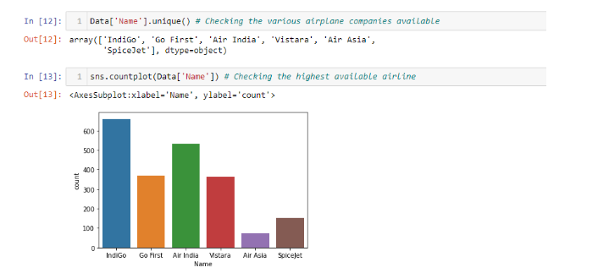
Encoding the object data types:
Checking the feature data
The below graph shows the various kinds of airlines available in yatra.com and which has the most availability while which has the least

Slide 11
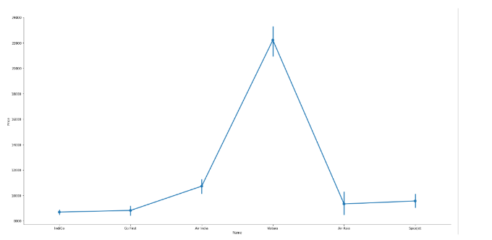
Clearly, Indigo has the highest availability while Air Asia has the lowest in the span of 30th October till 6th November from Delhi to Mumbai.
2) The next graph shows what are the various price range for each of the airline, this will give us the idea which airline has the cheapest ticket while which has the most expensive

Slide 12
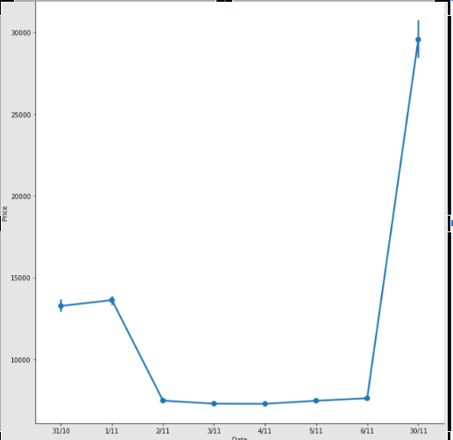
Clearly, Vistara has the most expensive ticket while Indigo has the cheapest ticket available.
3) The following graph shows the various price ranges in accordance with the date of purchase of the flight ticket. As mentioned earlier this data was taken on 30th October and flight prices of various airlines have been scrapped from 30th October till 6th November. Therefore we will be able to see how various dates influence the price of a ticket:

Slide 13
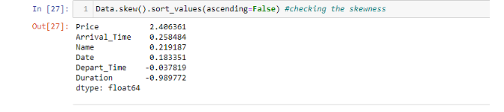
Therefore clearly, the price of a ticket is the maximum on last minute purchase, highest on the same date, while price drops if one books a flight ticket prior to 2-3 days from the date of boarding the flight.
Checking Data Skewness:
Here, apart from price, none of the data is skewed

Slide 14
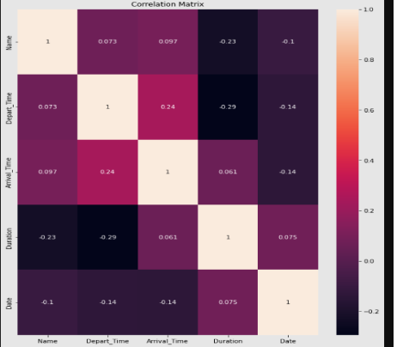
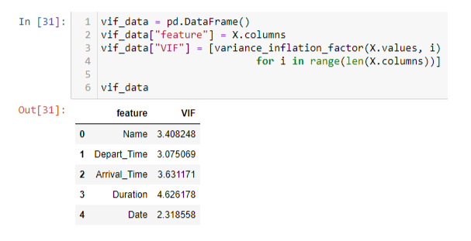
Checking Multicollinearity:
Heat Map:
2. VIF:
There is no issue of multicollinearity

Slide 15
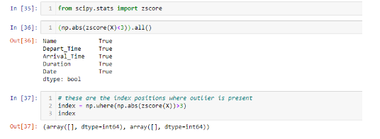
Checking Outliers:
By importing the zscore and checking the index position of the values which has a zscore higher than 3, it seems that there is no such data to imply that there is any possibility of an Outlier.

Slide 16
Model/s Development and Evaluation
(Linear Regression, Decision Tree Regressor, Random Forest Regressor and Gradient Boosting Regressor)

Slide 17
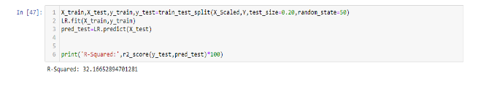
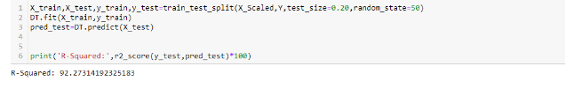
Linear Regression-32%
Decision Tree Regressor- 92%

Slide 18
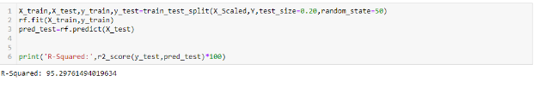
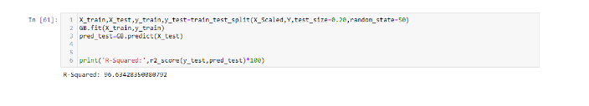
Random Forest Regressor -95%
Gradient Boosting Regression-96%

Slide 19
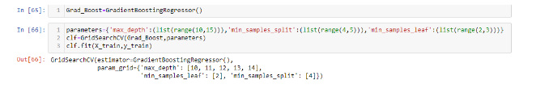

Hyperparameter Tuning:
The hands down winner from the above models is Gradient Boosting Regressor- giving the highest R squared score than the rest, however let us see if there is still any room of improvement in the score by tuning few of the parameters.
Enlisting the parameters:
Best parameters chosen:

Slide 20
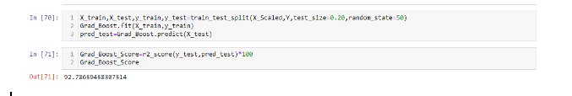
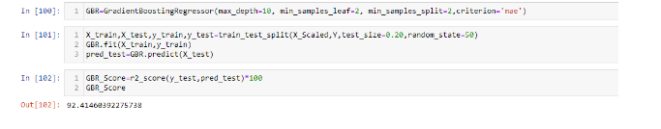
Checking the score:
It seemed that the score decreased with 92%, lets tweak the parameters further:
Even though tweaking the parameters- score still remained less than 96%.
Therefore based on the scores received, we will stick to the model of Gradient Boosting prior to hypertuning parameters.

Slide 21
Conclusion

Slide 22
Gradient Boosting Regressor was found to be the appropriate model for predicting flight price. Gradient boosting is one of the variants of ensemble methods where we create multiple weak models and combine them to get better performance as a whole. Therefore as we achieved and predicted the flight prices of various airlines from Delhi to Mumbai between 30th October and 6th November, the following three conclusions can be predicted.
Last minute purchases will always be expensive ( Prices were maximum on 30th October, there was a little dip on 31st October and 1st November- Price reduced hugely from 2nd November and remained constant till 6th November).
Vistara is more expensive as compared to other airlines from Delhi to Mumbai from 30th October till 6th November.
Indigo has the most availability of flights and has ticket prices cheaper as compared to the rest of the airlines.

Slide 23
Thank You!

